Slide 1
Baker Ripley:
Get-Out-the-Vote Analysis
Team SaPHIra
Dasha Selivonenko, Danielle Okuseinde, Hannah Watkins

Slide 2
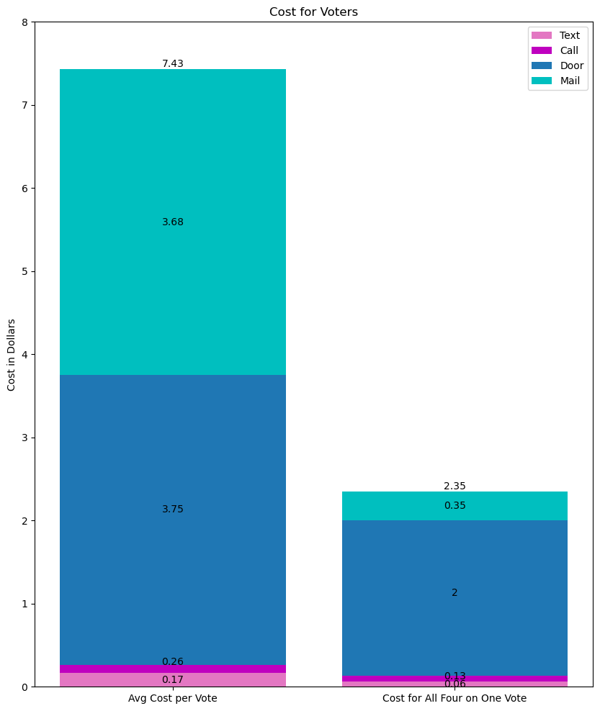
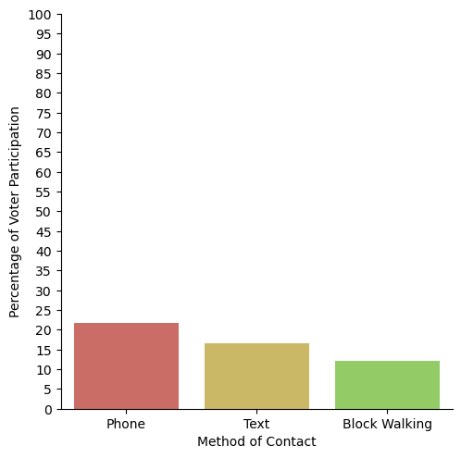
The Impact
Cost for Voters
Percentage of Voter Participation for Each Method of Contact

Slide 3
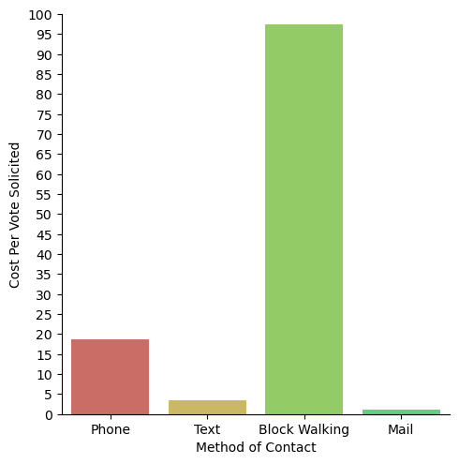
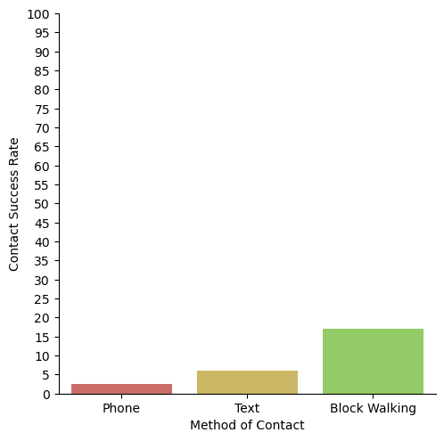
Diving Deeper
Contact Success Rate
Cost Per Vote Solicited for Each Method of Contact

Slide 4

In Perspective

Slide 5
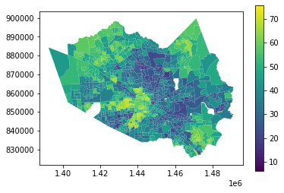
Voter Turnout Percentages in Precincts of Harris County

Slide 6
Precincts with the Maximum and Minimum Turnout

Slide 7
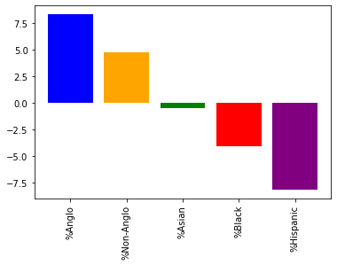
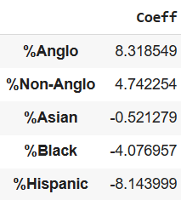
Linear Regression: Which demographic groups are the strongest indicator on voter turnout?

Slide 8
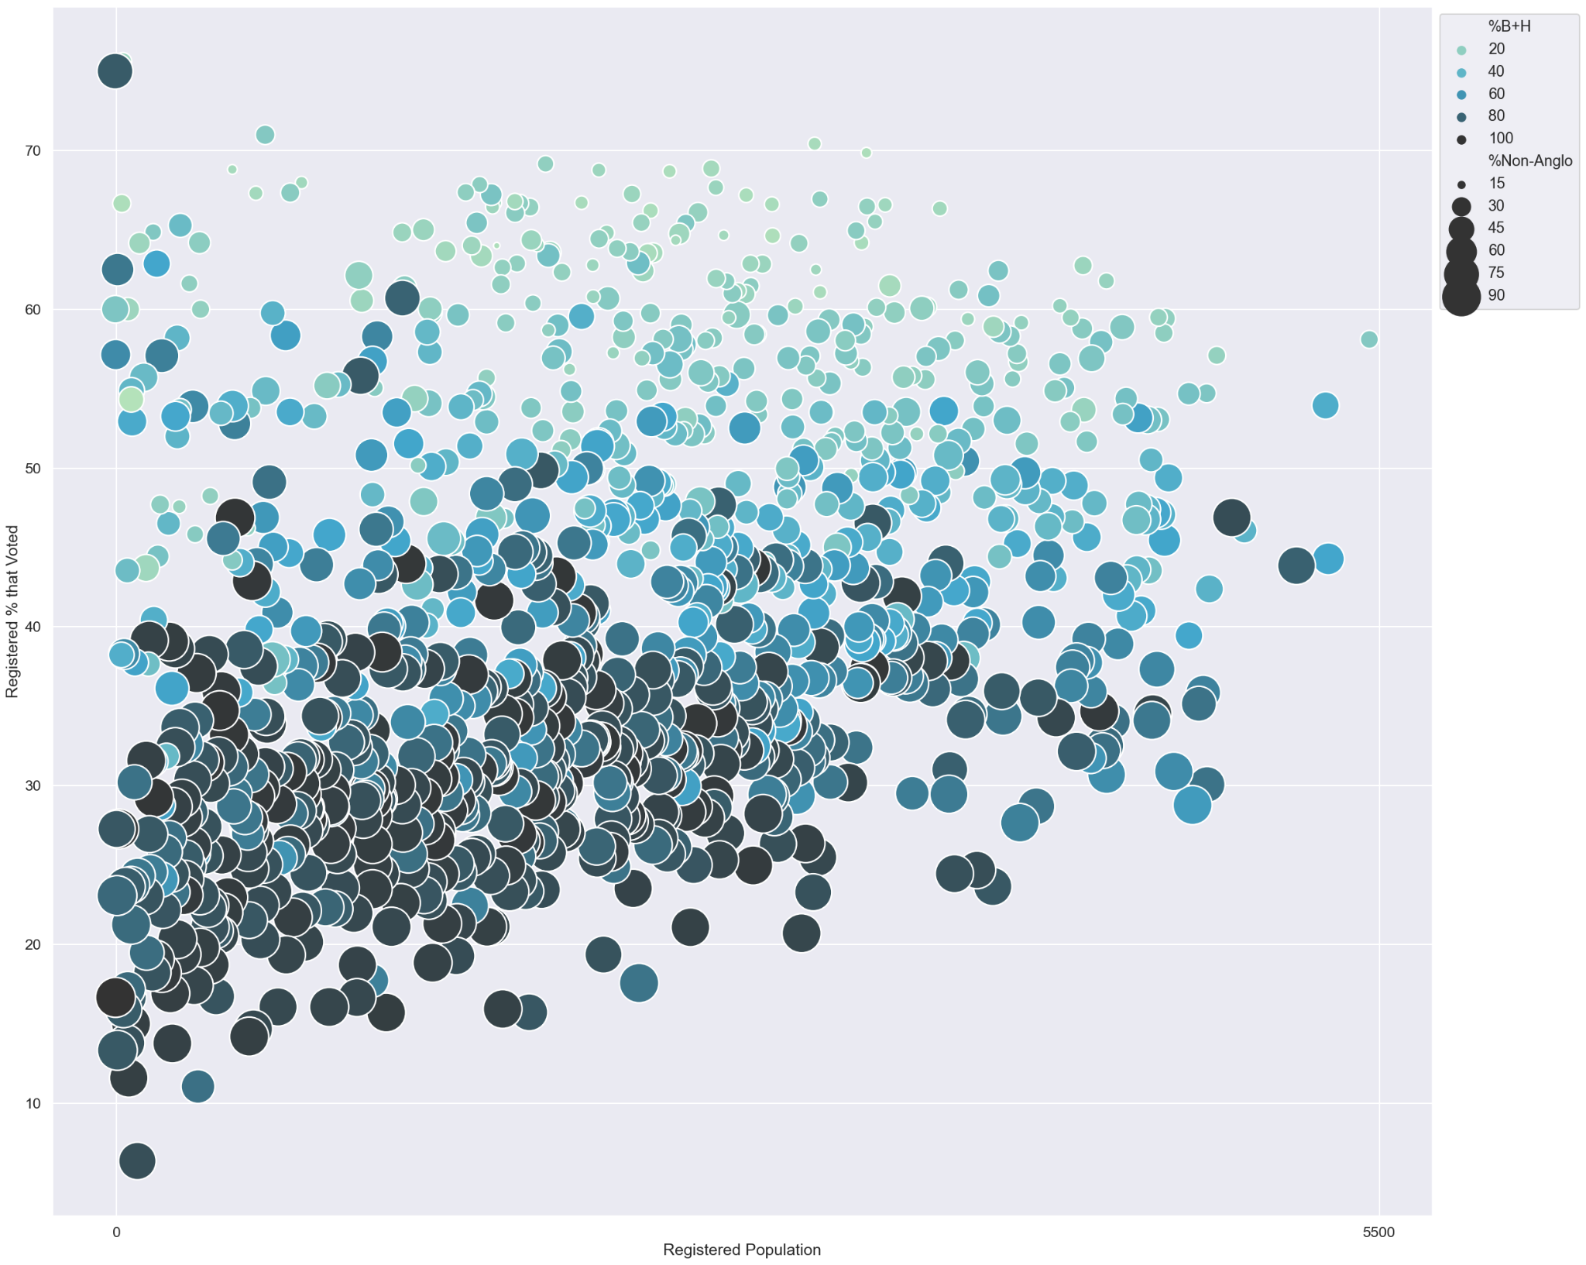
Registered Voters in Relation to Racial Demographics
Registered % That Voted
Size of Registered Population

Slide 9
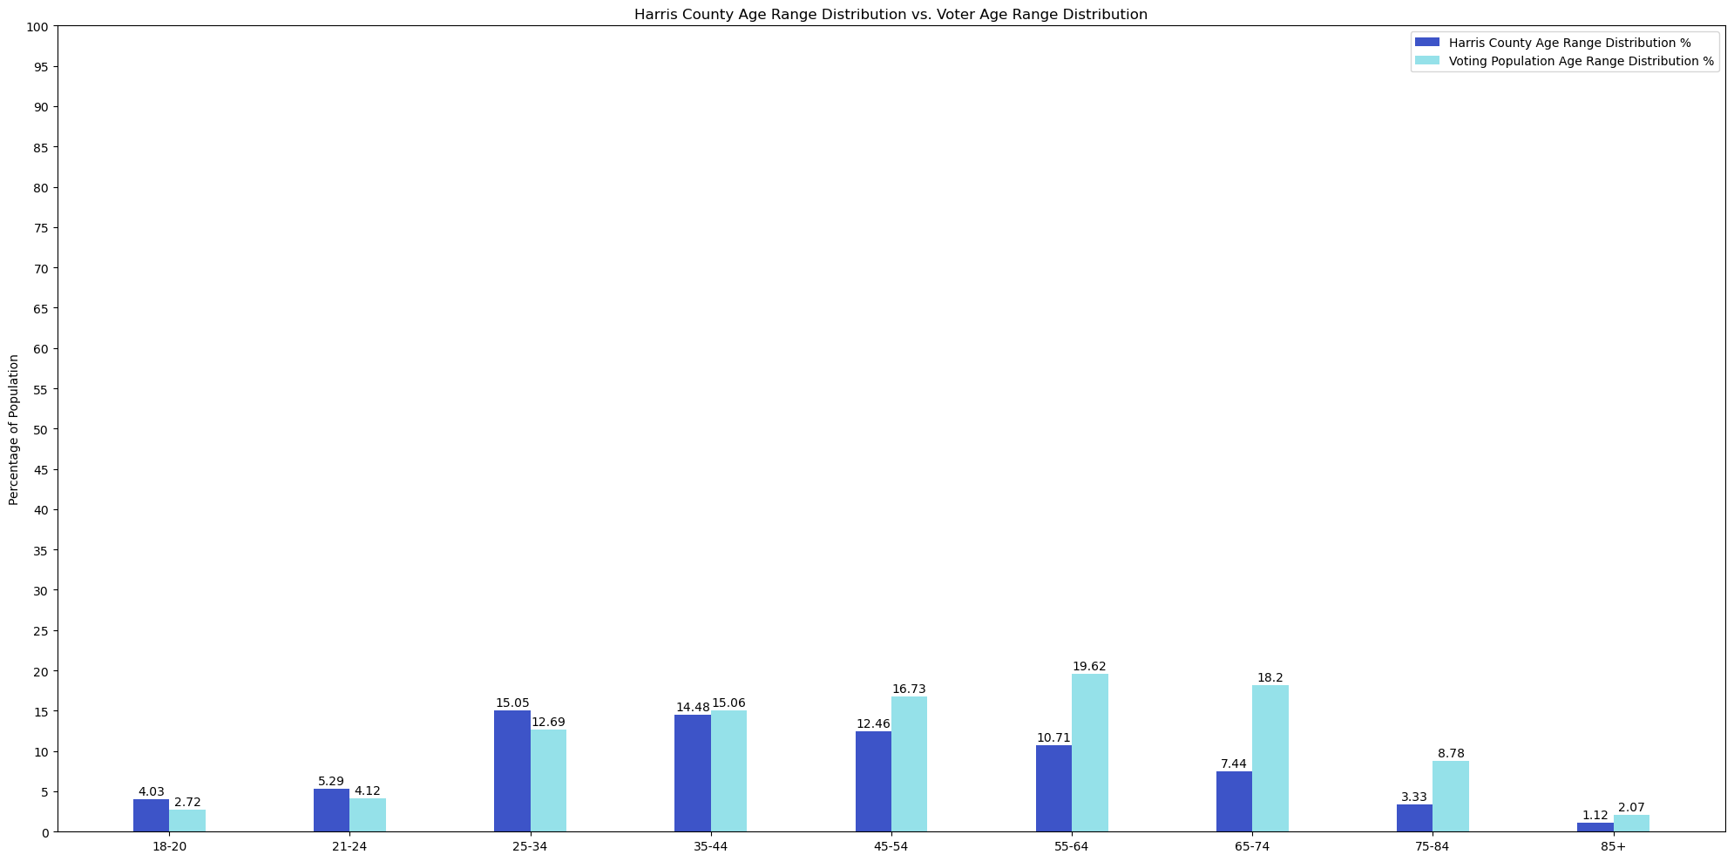
Age Range Distribution Percent
Voting Age Groups

Slide 10
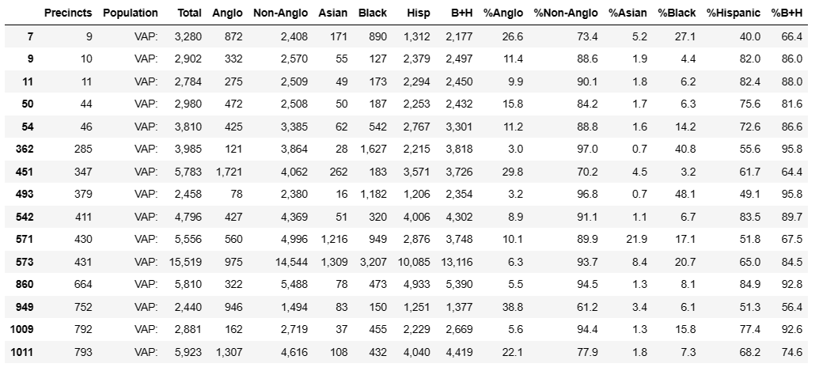
BakerRipley Targeted Precincts

Slide 11
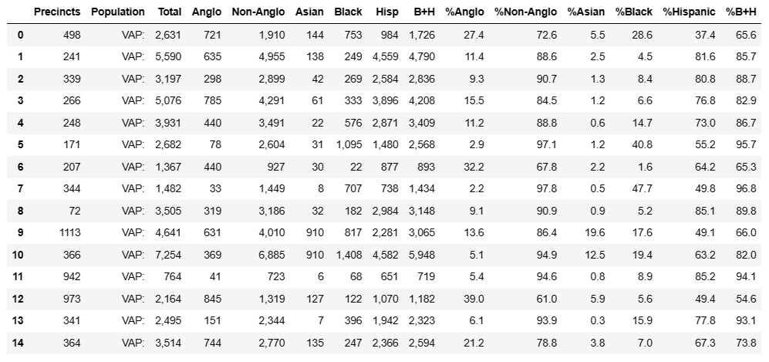
Corresponding Similar Non-Targeted Precincts

Slide 12
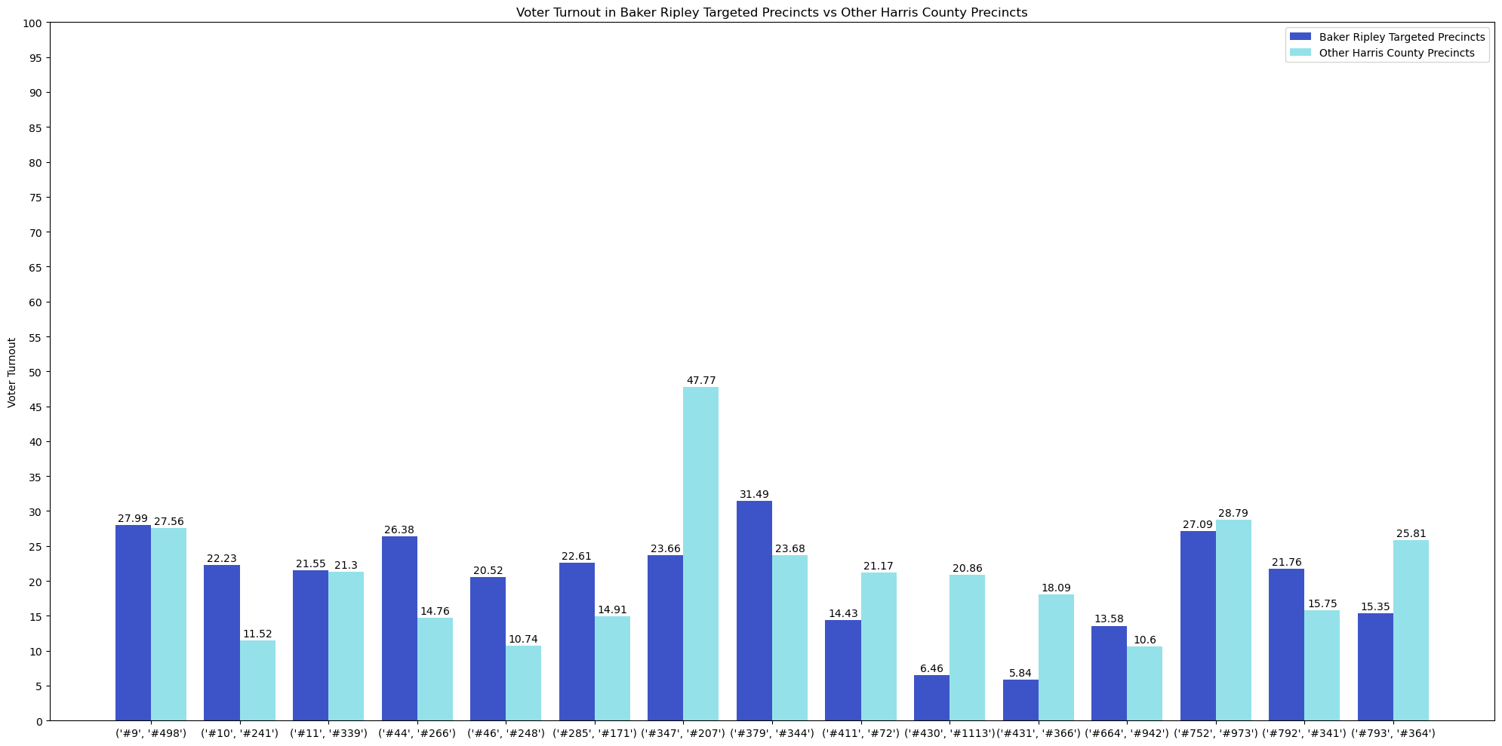

Slide 13
Taking Everything into Account
Knowing whether or not BakerRipley had a positive impact on their targeted precincts is also dependent on what the turnout of those precincts were in past years
Competitive district races
Missing other demographic variables for the entire registered population
Age, race for specific registered voters
Average socioeconomic status for each precinct

Slide 14
What Can BakerRipley Do?
According to our analyses…
BakerRipley needs to focus on increasing voter turnout among younger voters, specifically 18-34.
They should also target precincts that have greater Hispanic populations to encourage voter participation.
Phone Calls were the most cost effective and high yielding solicitation method.

